Slide 1


EDEN Communities of Practice- Shaping A Better „New Normal”
Dr. Sandra Kučina Softić, M.Sc. in Digital Education
President of EDEN
Assistant Director at the University Computing Centre SRCE
sskucina@srce.hr

Slide 2
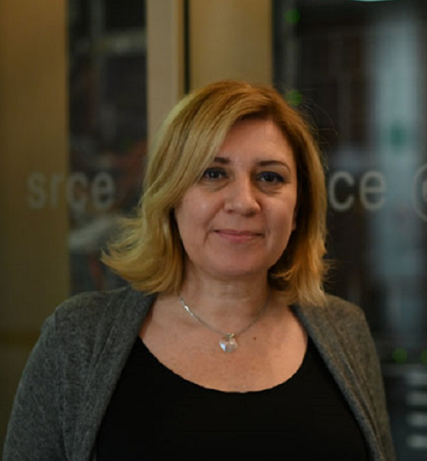
About me
Working for 25 years in HE on implementation of digital technologies into educational process and support to institutions, teachers and students in this process
Manager, trainer, teachers, learner…
M.Sc. In Digital Education, University of Edinburgh
PhD. In Information and Communication Technologies, University of Zagreb
Head of the E-learning Centre at the University Computing Centre SRCE
Assistant Director at the University Computing Centre SRCE University of Zagreb
President of the European Distance and E-learning Network EDEN
I love my job!

Slide 3
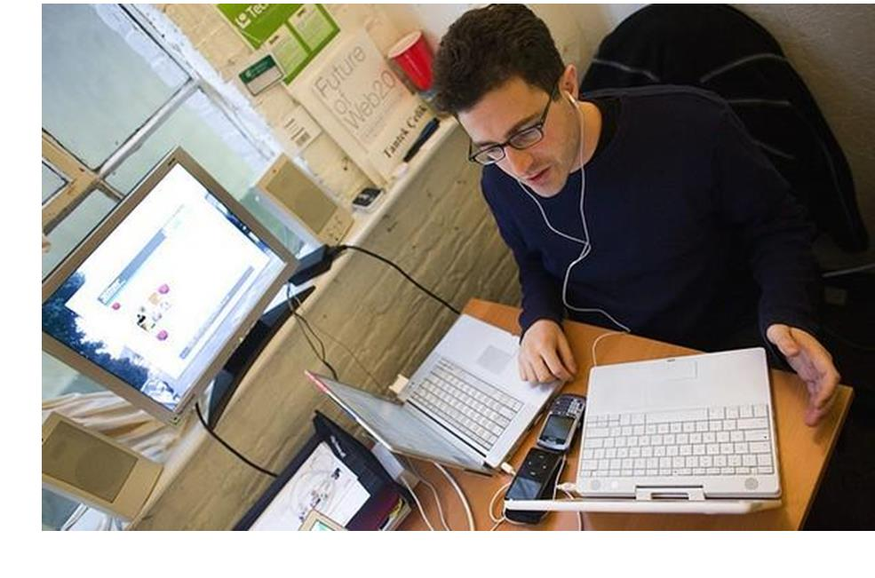
Education and crises caused by COVID-19
Biggest disruption in education in history
Transition and adaptation to work, study and life in an online environment, environemnt with limitations and less freedom
Even greater digital divide in society - people who do not have access to the Internet, do not have computers and do not have digital skills
Education institutions and teachers unprepared for going online
Technology is seen as complement rather than transform practice
Emergency remote teaching dominate
Online education taken as the deficit model, second best
Major financial impact on the global higher education
https://drjanestewart.wordpress.com/2014/11/23/the-effects-of-multitasking-on-learning/

Slide 4
Education and crises caused by COVID-19 (2)
Pandemic challenged many existing assumptions and routines
  Those teachers who have used e-learning before, easier and faster moved their teaching online
  Those teachers who did not use any digital tools in their teaching had more difficulties to find out how to organize their teaching in online environment
Lack of teachers’ digital skills resulted in low use of possibilities of digital technologies, high workload and stress
Teacher could not do it by themselves any more, they needed help and support in following:
  Which digital technologies to use?
  Are they available?
  How to use?
  How to implement them into educational process?
Lack of students’ digital skills resulted in confusion and stress

Slide 5
Discussion
What is your idea of community of practice and have you been a member of one?
What benefits do you see being a member of community of practice?

Slide 6
Types of collaboration
Professional Learning Communities (PLC)
Professional Learning Networks (PLN)
technology plays a major role in modern teacher collaboration
teachers collaborating in PLCs is one way of teacher learning
actively participating in a PLN on a social network gives you direct access to the knowledge, experience, and resources of countless educators who you may have never connected with in your immediate professional circles.

Slide 7
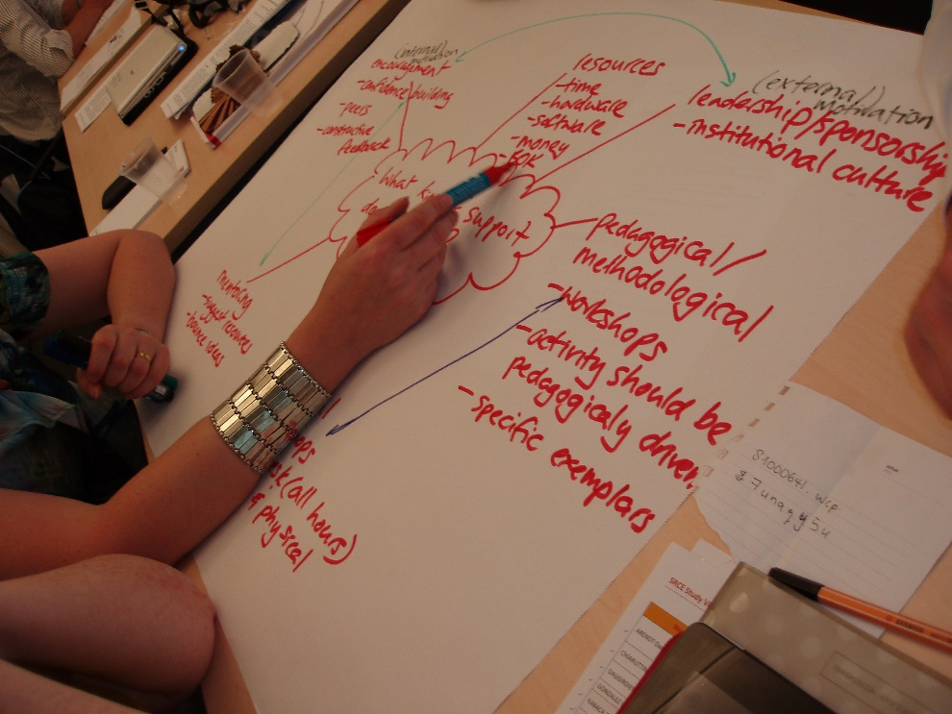
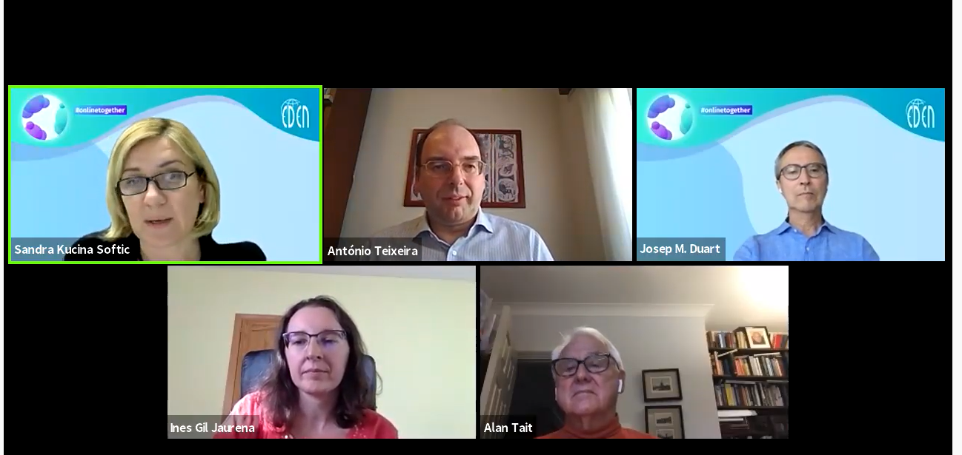
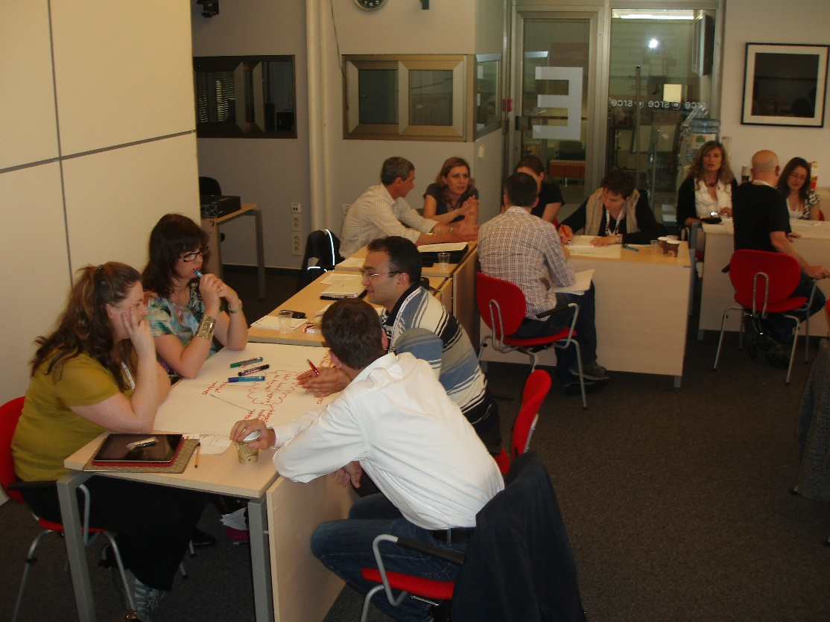
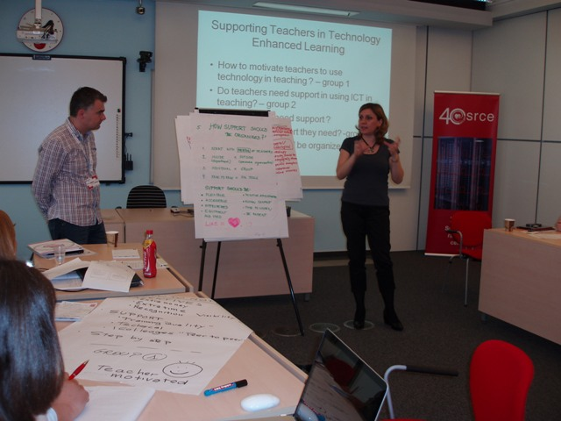
Professional collaboration
To use digital technologies to engage in collaboration with other educators, sharing and exchanging knowledge and experience, and collaboratively innovating pedagogic practices

Slide 8
What are communities of practice?
Some common terms: professional learning groups, collaborative learning communities, critical friends groups, professional learning communities
group of people who have a common area of interest or a common concern. They build a trusted relationship between themselves on topical areas of common interest, and share their unique knowledge and experience related to the issue
groups of teachers who meet regularly as a team to analyze current levels of achievement, set achievement goals, identify essential and valued student learning, develop common formative and common summative assessments, share strategies, and research best practices. The expectation is that this collaborative effort will produce ongoing improvement in student achievements

Slide 9
Communities of practice (professional learning communities)
Enables teachers to develop new understanding and apply it to their classroom to raise student achievement. Increased student achievement is the indicator of a successful PLC
an ongoing process in which educators work collaboratively in recurring cycles of collective inquiry and action research to achieve better results for the students they serve
the powerful collaboration that characterizes professional learning communities is a systematic process in which teachers work together to analyze and improve their classroom practice (f2f or online) - this process, in turn, leads to higher levels of student achievement

Slide 10
Six essential characteristics crucial to creating a collaborative climate emerged through the investigation
relational trust (essential element for establishment of strong foundations for rich collaboration, collaboration is grounded in trust, safety and strong relationships)
collective responsibility (supports a culture of growth and is critical to enhancing the idea that we are all in this together to improve teaching and learning, shift from me and my, to we and our)
clear purpose (Developing a clear purpose needs to be an inclusive process that will involve all parties. It requires starting with a vision or big picture and then narrowing down to specific goals that will capture the vision and progress student achievement )
time allowance (structural changes may need to be made to allow time for participants to talk, reflect and act on changed practice; High quality outcomes need time to be truly embedded )
effective communication (Well-developed communication channels, created early in the establishment of a collaborative community, enable ideas to be shared and new knowledge to be created and used.)
collective inquiry (process by which educators build shared knowledge and learn together, using student evidence of learning as the basis for the inquiry, those involved in the inquiry seek to solve problems or issues of practice that affect student achievement)

Slide 11
Professional learning communities tend serve to following broad purposes
improving the skills and knowledge of educators through collaborative study, expertise exchange, and professional dialogue,
improving the educational aspirations, achievement, and attainment of students through stronger leadership and teaching.
develop the concept of “thinking together” which enables them to build a collective knowledge base. This leads to improved individual performance of each member and can have significant impact on understanding, applying and using the topics that were drawn together to address.

Slide 12
Situation recently
most teachers still have to work in educational institutions where policies are outdated and curricula no longer cover the skills required for today's society
Teachers often feel isolated in their own institution, confined to a single institution experience as tight timetables and overloaded curricula do not allow them enough time to explore innovative pedagogies
increasing computational power and the emergence of the Internet has had a great impact on the way teachers are doing their jobs
unprecedented opportunities brought about by networking tools are enabling teachers to network and collaborate with other teachers from anywhere, at any time.

Slide 13
Professional collaboration as a key support for teachers working in challenging environments
For teachers, the sudden switch to teaching online has prompted a reboot in terms of teaching methods and course design. When trying something new, the best way to evaluate the outcome before moving forward is to reflect
Collaboration with colleagues allows teachers to learn from each other’s expertise, share knowledge within their professional community and, ultimately, improve the instruction and support they can give to their students
Self reflection as the act of articulation of own thoughts (journal, blog)
Technology plays a major role in modern teacher collaboration

Slide 14
Discussion
What a community of practice should have to satisfy educators needs?

Slide 15
How can teachers benefit from participation in PLN
using and interacting with new ICT applications (improving ICT skills)
to gain cultural competence through the provision of online tools
to meet virtually and create projects with teachers from different countries and collaborate via the Internet
to further develop a wide array of interpersonal skills, such as communication, cooperation and better time management
the opportunity to collaborate in another language
to ameliorate their leadership skills, through managing people, taking initiative and learning to support and instruct team work.
opportunities to be creative, to develop their own ideas and learn how to learn through collaboration
to have fun and feel part of the community

Slide 16

How can EDEN help educators and education institutions in crisis…
By talking and tackling the most present and important topics related to the digital learning and teaching
Bringing EDEN community and all interested to discuss, to exchange ideas and knowhow
Providing ground for collaboration and joining of efforts to foster the digital education and digital culture for better life and wellbeing in todays and tomorrow world
https://www.cavill.com.au/product/f2f-to-online-consultancy/

Slide 17



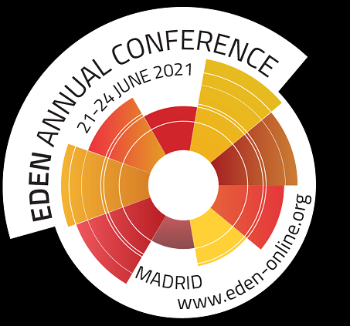
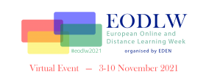
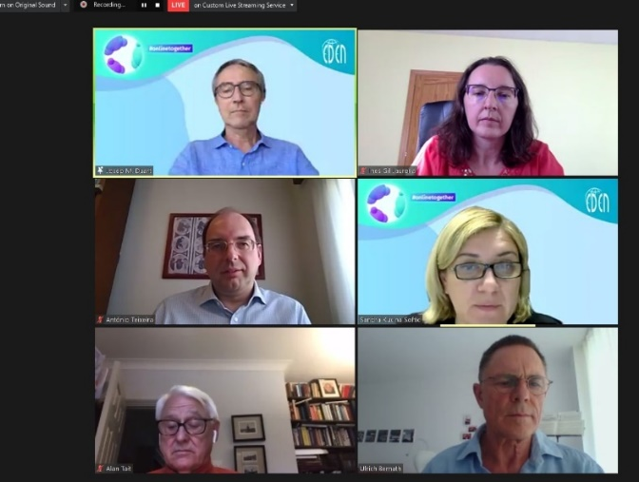
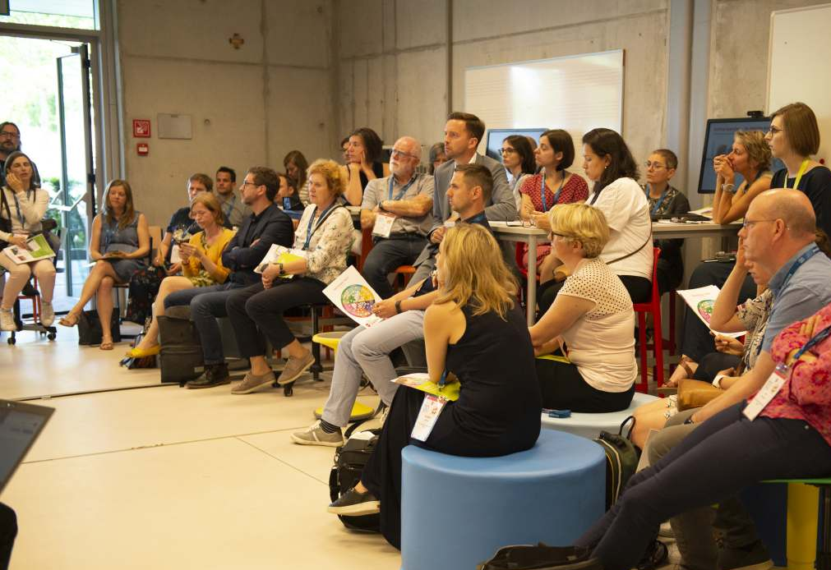
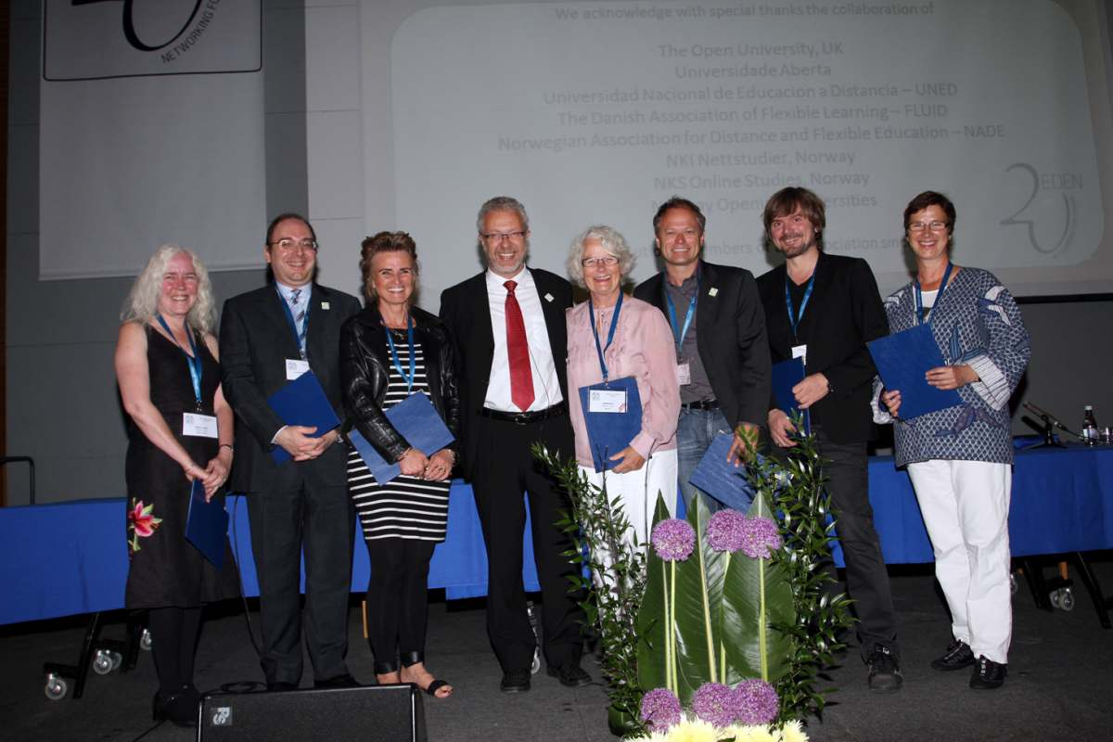

http://www.eden-online.org
      EDEN in numbers
      Institutional members 188
      Individual members 286
      Individuals in the Network of Academics and Professionals: 1053
      55 countries
      Over 430 institutions from Europe and other continents
EDEN
exist to share knowledge and improve understanding amongst professionals in distance and e-learning and to promote policy and practice across the whole of Europe and beyond.
smart network for the professional community and a professional community for smart learning

Slide 18
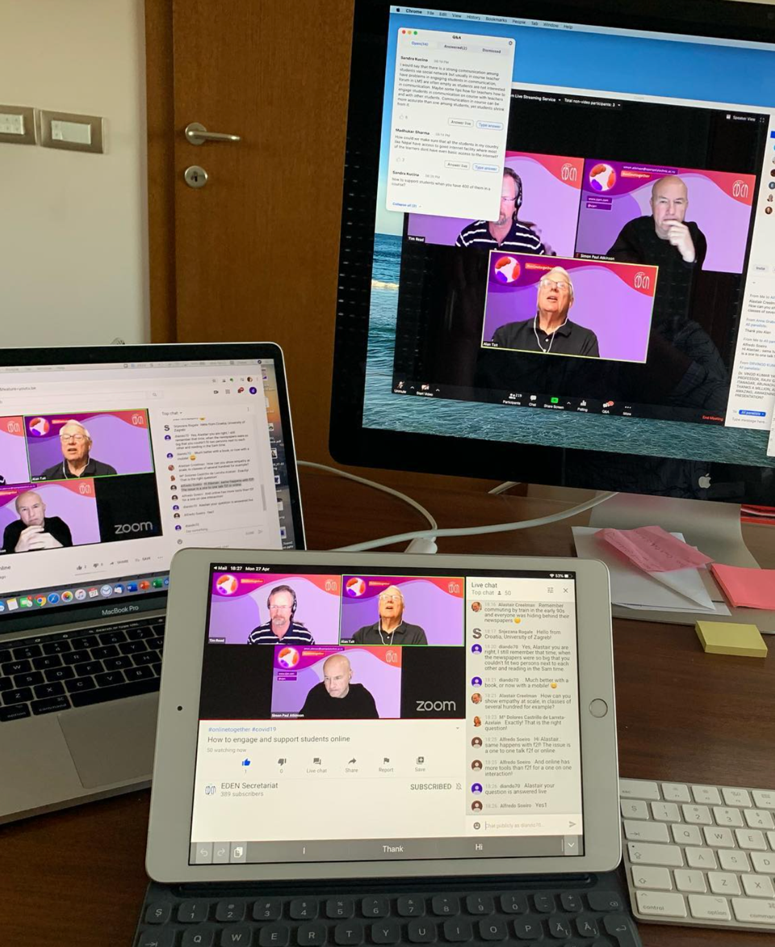
EDEN initiative - webinars #onlinetogether
Started on March 30, 2020
Prompt response of the EDEN to the pandemic and situation in education
to support the education community worldwide and provide practice-oriented advice combining methodology and technology, examples and resources, to those faced with the challenges of taking present educational practice on a higher level.
Practical webinars on how to take face-to-face education online
Focus on the day-to-day challenges teachers and educators face
Spring Series 2020: Education in Time of Pandemic: 11 webinars
Autumn Series 2020: Education in Time of New Normal: 6 webinars
Spring and Autumn Series 2021: Time for Action in Shaping the HE 4.0: 7 webinars
98 speakers and moderators

Slide 19
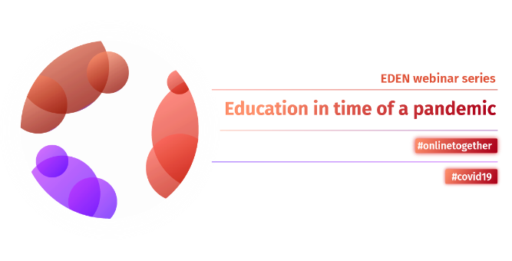
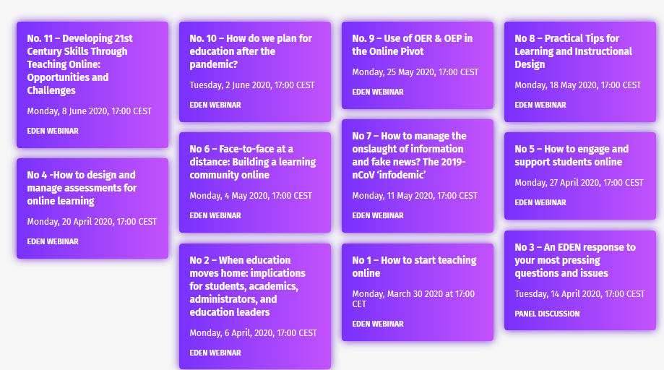
Series#1: Education in time of pandemic
webinars #onlinetogether
Started on March 30
Practical webinars on how to take face-to-face education online
Focus on the day-to-day challenges educators face
11 webinars
35 speakers and moderators
Over 3500 participants
From over 120 countries worldwide
More than 9100 views of
recordings

Slide 20
Number of Participants by Country
 | Country | Participants
1 | Croatia | 1356
2 | Germany | 445
3 | Portugal | 375
4 | Romania | 331
5 | Italy | 239
6 | United Kingdom (UK) | 226
7 | Spain | 217
8 | Latvia | 205
9 | Ireland | 194
10 | India | 169
11 | Sweden | 164
12 | Belgium | 139
13 | South Africa | 111
14 | Greece | 100
15 | Philippines | 96
16 | Serbia | 87
17 | Canada | 86
18 | Turkey | 80
19 | United States of America (USA) | 73
20 | Ukraine | 64

Slide 21
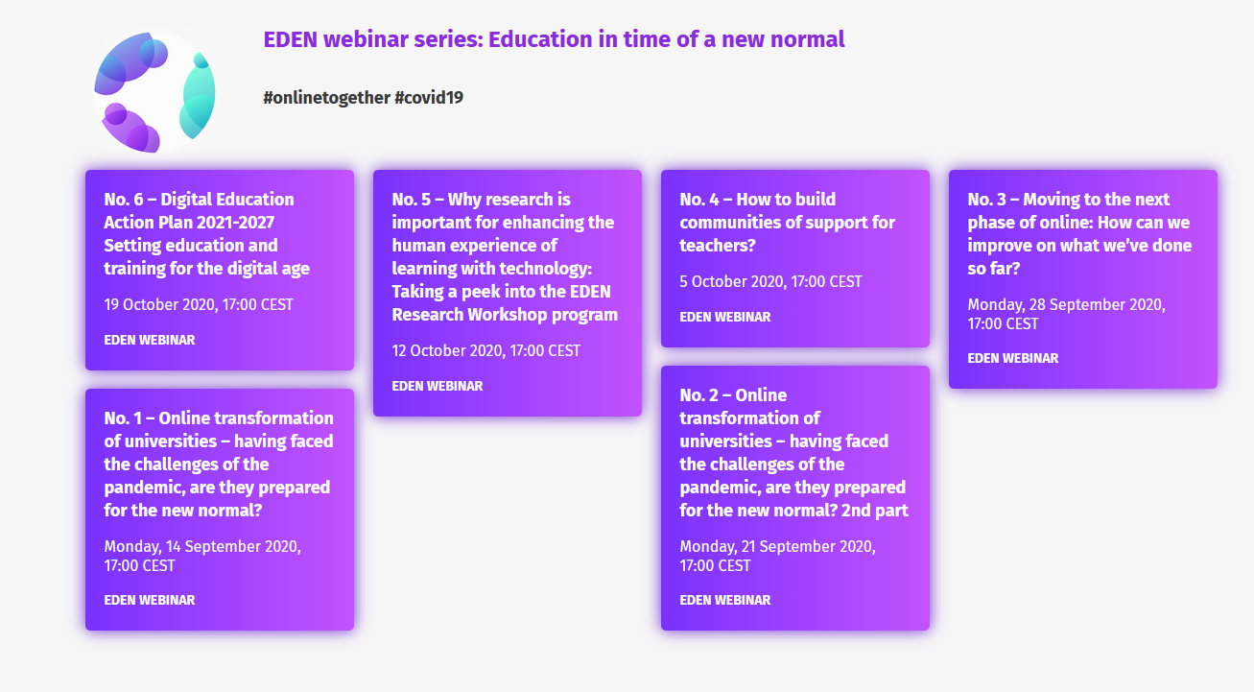
Series#2: Education in time of new normal
webinars #onlinetogether
Started on September 14th, 2020
6 webinars
26 speakers and moderators
Over 800 participants
Presentation of the Digital Education Action Plan by European Commission
Recordings available at: http://www.eden-online.org/

Slide 22
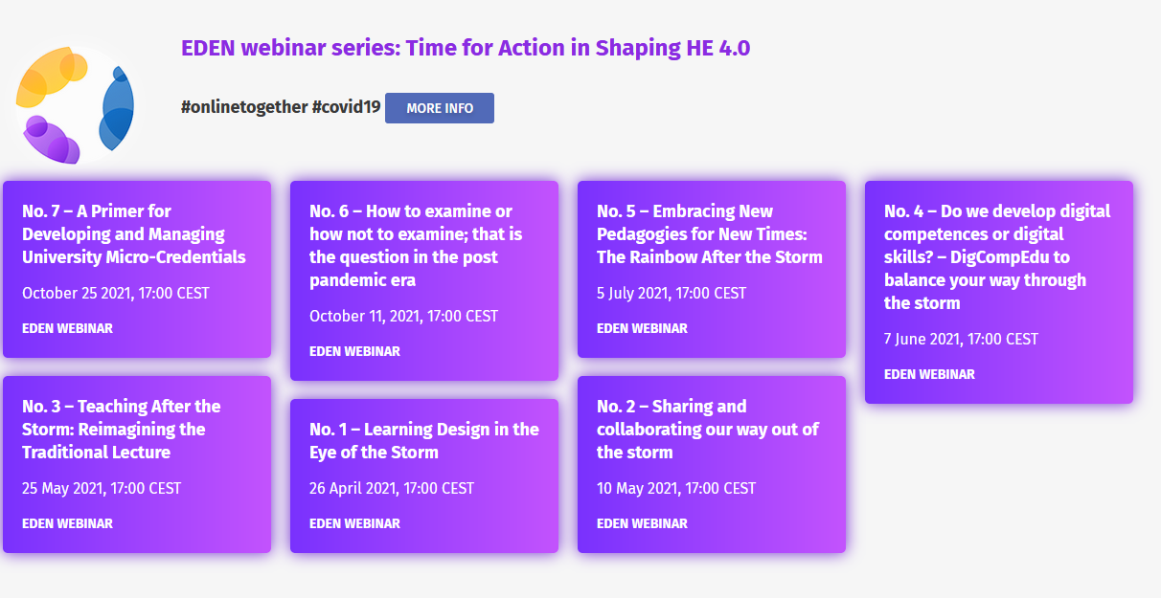
Series#3:Time for Action in Shaping HE 4.0
Recordings available at: http://www.eden-online.org/
Started on April 26, 2021
7 webinars
32 speakers and moderators
Over 860 participants
View of recordings 1011
Last session of the series to be held on 25 October 2021

Slide 23
EDEN initiative - webinars #onlinetogether
Series | Total participants
#1 | 3552
#2 | 923
#3 | 868
Total | 5343
Geographical Area | Number of responses | %
Europe | 374 | 84,4
North America | 7 | 1,6
South America | 10 | 2,3
Asia | 37 | 8,4
Antarctica | 6 | 1,4
Oceania | 9 | 2

Slide 24
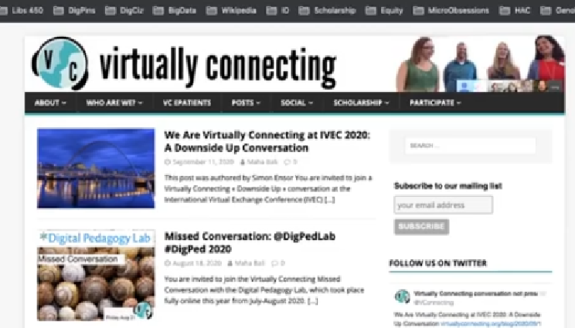
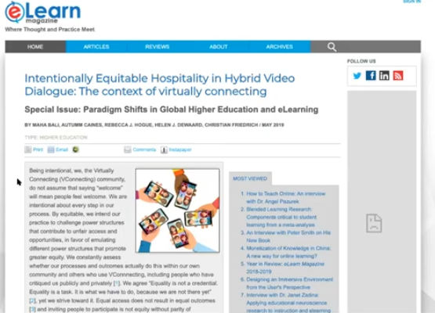
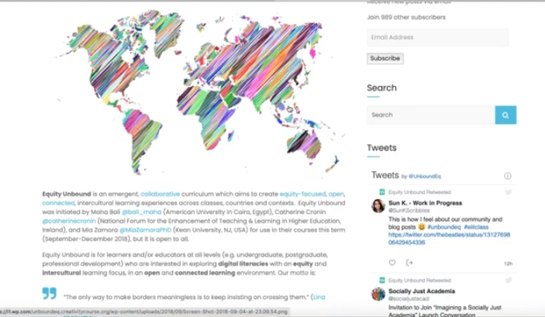
How to build communities of support for teachers?
EDEN webinar within the initiative Education in time od new normal
October 5th, 2020
Recording available: http://www.eden-online.org/eden_conference/how-to-build-communities-of-support-for-teachers/

Slide 25
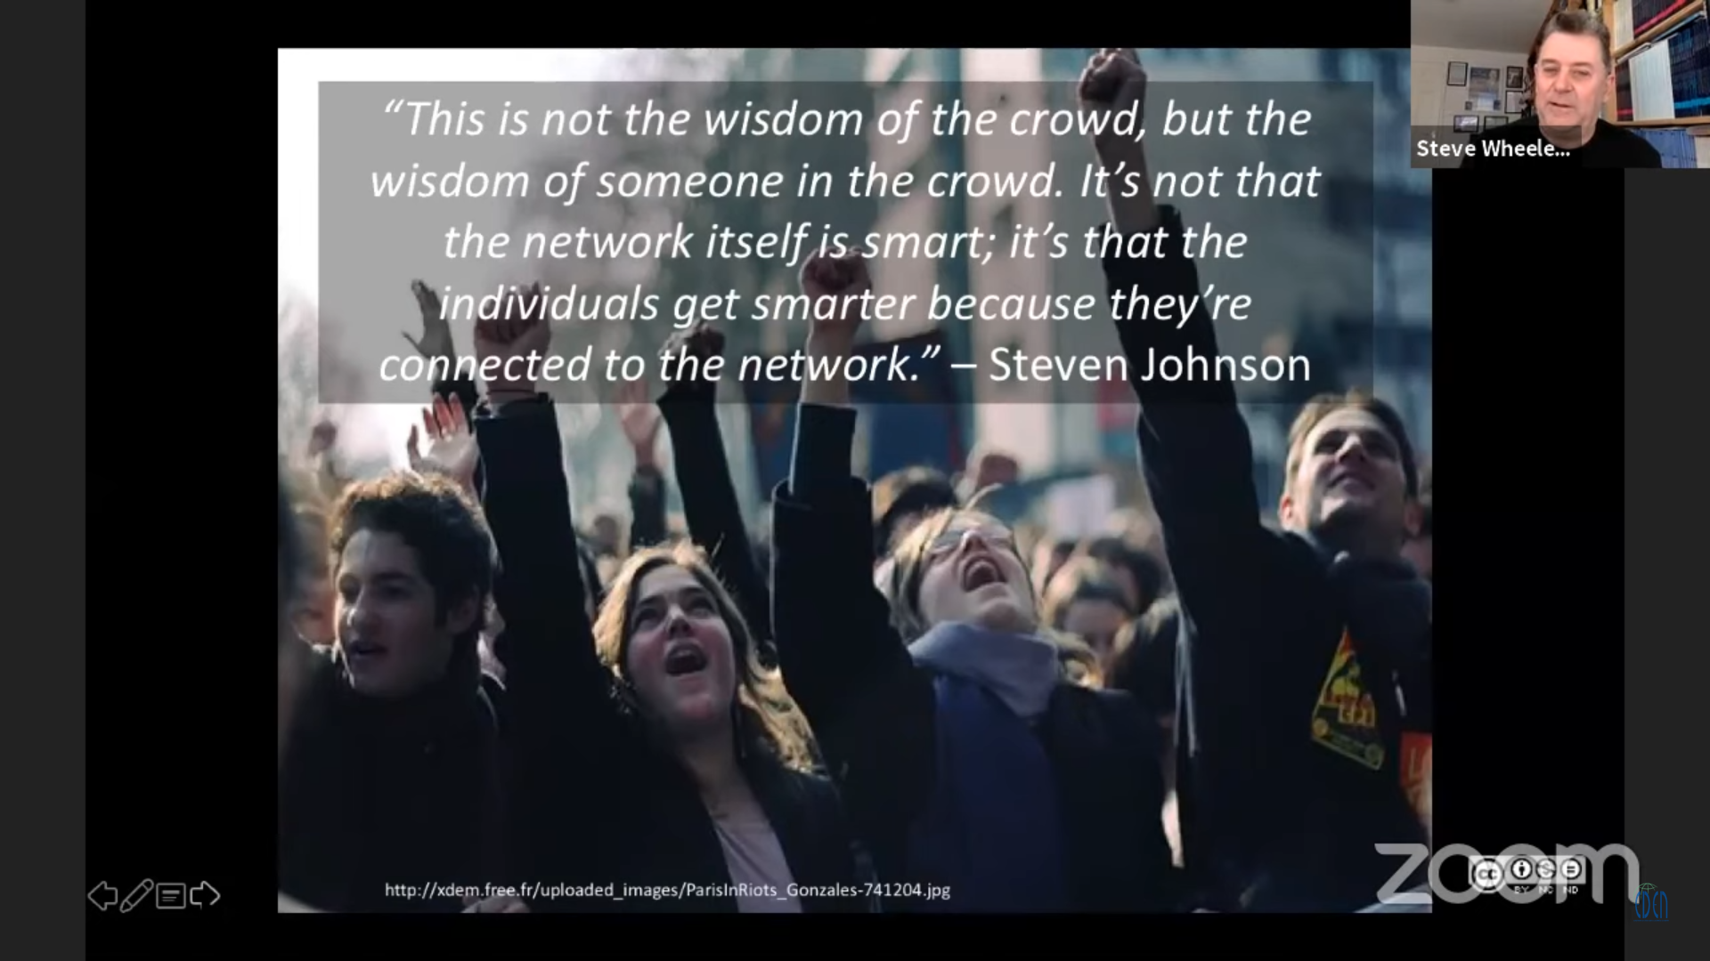
Steve Wheeler - Building online communities of learning
EDEN webinar within the initiative Education in time od pandemic
May 4th, 2020
Recording available: http://www.eden-online.org/eden_conference/face-to-face-at-a-distance-building-a-learning-community-online/

Slide 26
Discussion
How can we continue to leverage and strenghten educators resilience to present situation?

Slide 27

Possible scenarios…after pandemic
Restore. We will be focused on figuring out what to do to get back to where we were before the pandemic.
Evolve. We will be focused on adapting to the new normal.
Transform. We will be focused on redefining our institution and taking an active role in creating the innovative future of higher education.
Which scenario will you choose?

